Slide 2
Recommendation Report
Session ID: 9abfec21-cd10-4fb6-a65b-1137fe6cc7ef
Generated: 2025-04-25

Slide 3
Fragment: Green With Software

Slide 4
Green With Software: Top 3 Insights
The organization’s IT delivery model is heavily weighted towards short-term projects rather than long-term product development, hindering scalability and creating technical debt. Shifting focus to building and maintaining reusable IT products, supported by training in integrated operating models and collaborative tools, is critical for sustained value.
The current IT architecture demonstrates foundational modernization but lacks a strategic roadmap for adopting key principles of modern application development, specifically microservices and API-driven integration. Developing and executing a phased architectural evolution plan, prioritizing API enablement, will be essential to improve agility and responsiveness to business needs.
Cloud adoption is currently reactive and lacks governance, resulting in inconsistent implementation and potential security/cost inefficiencies. Establishing a formal cloud policy, automating infrastructure provisioning, and defining a clear hybrid cloud strategy are necessary to realize the full benefits of cloud technologies.

Slide 5
Green With Software: Roadmap Overview
Summary: This roadmap guides the transition from a project-driven IT landscape to a product-centric model, emphasizing architectural modernization, data-driven decision-making, and enhanced agility. It focuses on establishing a purposeful hybrid cloud strategy and fostering a culture of innovation to improve business outcomes and sustainability.
Total Est: 94 hrs (~11.8 days)
Key Roles: Developers, IT Architects, Data Analysts, Project Managers, Security Professionals, Innovation Leaders, Operations Engineers

Slide 6
Green With Software: Implementation Plan Details
Overall Goal: Green With Software Implementation Plan
Description:
This roadmap outlines a phased approach to modernize IT operations and drive business value. The Early Steps focus on foundational alignment and experimentation with collaborative tools and cloud technologies. Intermediate Steps concentrate on integrating agile practices, modernizing the IT architecture with a mix of database technologies, and automating processes. Finally, the Advanced Steps shift towards persona-based operations, strengthen critical event support, and prioritize realizing tangible business benefits through data-driven insights and improved sustainability metrics.
Methodology / Steps:
--- Early Steps ---
1. Introduce collaborative project management tools like Jira, Trello, or OpenProject. 2. Implement basic sustainability checkpoints in project development. 3. Provide training on integrated operating models. 4. Experiment with cloud usage for one-off projects and develop a cloud policy to guide experimentation. 5. Begin collaborative efforts for basic data management and explore integrable data sources for improved analytics. 6. Start documenting data processes and insights. 7. Introduce basic agile principles and encourage team collaboration. 8. Implement visual project management using Kanban.
--- Intermediate Steps ---
9. Implement a mix of enterprise databases and NoSQL solutions for increased flexibility. 10. Transition towards Agile and continuous integration practices. 11. Introduce virtualization technologies for enhanced resource utilization.
--- Advanced Steps ---
12. Shift focus from ticket-based to persona-based operations and encourage solution adoption with persona-based training. 13. Strengthen critical event support. 14. Target projects to deliver tangible business benefits and measure success based on positive movement in business-related KPIs. 15. Evaluate the percentage of improvement in productivity from moving to product-centric IT.
Roles Involved (Overall): Developers, IT Architects, Data Analysts, Project Managers, Security Professionals, Innovation Leaders, Operations Engineers
Tools/Platforms (Overall): Jira, Trello, Git, VersionOne, Bitbucket, AWS CLI, Google Sheets, Kanban, OpenProject, MongoDB, Jenkins, Docker, Kubernetes, Red Hat OpenShift, Amazon ECS, Prometheus, Cherwell, Smartsheet, Odoo
Subtask Estimates (Aggregated):
--- Early Steps ---
Project Management Tooling: 8h; Sustainability Checkpoints: 4h; Integrated Operating Model Training: 4h; Cloud Experimentation: 6h; Cloud Policy Development: 4h; Data Collaboration: 4h; Data Integration Exploration: 4h; Data Documentation: 2h; Agile Introduction: 4h; Team Collaboration: 2h; Visual Project Management: 2h
--- Intermediate Steps ---
DB/NoSQL Integration: 6h; Agile/CI Transition: 6h; Virtualization Implementation: 4h
--- Advanced Steps ---
Persona-Based Operations: 6h; Critical Event Support: 4h; Benefits Realization Management: 6h; Solution Adoption Training: 10h; KPI Measurement: 10h

Slide 7
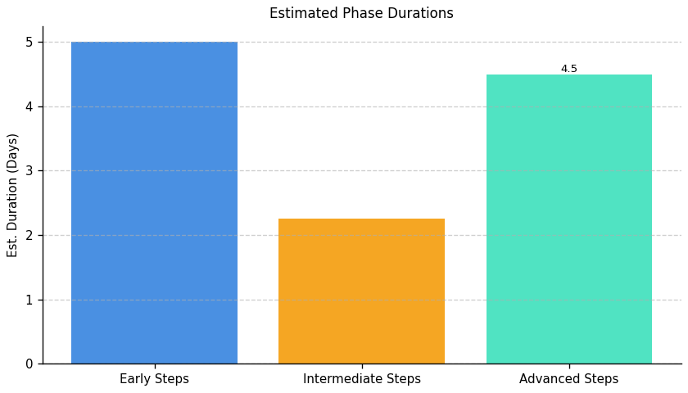
Green With Software: Roadmap Phase Durations

Slide 8
Fragment: Green With Software

Slide 9
Green With Software: Top 3 Insights
The organization’s server infrastructure lacks essential management practices for reliable operation and future growth. Specifically, there’s no evidence of implemented strategies for scalability, resource monitoring, redundancy, or load balancing, indicating a high risk of performance issues and outages as demand increases.
Security is a critical weakness, with fundamental controls like intrusion detection, robust access management, and consistent log auditing missing. This absence creates substantial vulnerabilities to data breaches, system compromise, and potential non-compliance with industry regulations.
Despite some reactive security measures like patching and alerting, the overall IT operations approach is inconsistent and immature. Positive practices are isolated and do not compensate for the significant gaps in foundational infrastructure and security management, suggesting a need for a comprehensive, proactive overhaul.

Slide 10
Green With Software: Roadmap Overview
Summary: This implementation roadmap addresses critical gaps in server infrastructure resilience, security, and scalability. It outlines a phased approach to enhance monitoring, implement redundancy, and ensure compliance with industry regulations, ultimately improving the overall stability and security posture of the environment.
Total Est: 495 hrs (~61.9 days)
Key Roles: IT Architects, Infrastructure Managers, Scalability Planning Team, IT Leadership, IT Administrators, Infrastructure Team, IT Specialists, Monitoring Team, Monitoring Administrators, Security Analysts, Testing Teams, Business Analysts, Network Administrators, Optimization Experts, Compliance Specialists, Logging System Analysts

Slide 11
Methodology / Steps:
--- Early Steps ---
1. Assess the current server infrastructure for scalability gaps, conducting workload analysis and collaborating with IT architects. 2. Evaluate and select a resource monitoring tool, researching options and aligning with requirements. 3. Conduct a security threat assessment to identify potential risks and vulnerabilities, collaborating with security experts. 4. Analyze current and projected.
--- Intermediate Steps ---resource demands, collecting usage data and collaborating with business and IT teams. 5. Conduct a network assessment to identify areas for optimization, using network monitoring tools and analyzing traffic patterns
6. Develop a plan for enhancing server infrastructure scalability, identifying solutions and creating a roadmap. 7. Configure and integrate the selected monitoring tool with the server infrastructure, following documentation and testing configurations. 8. Evaluate and select an IDS solution, researching tools and aligning with the threat assessment. 9. Develop a plan to ensure server resources meet current and future demands, defining resource allocation strategies and collaborating with IT and business teams. 10. Develop a plan outlining network optimizations based on assessment findings, collaborating with network experts and prioritizing improvements.
--- Advanced Steps ---
11. Implement the planned upgrades to enhance scalability, upgrading hardware and implementing scaling solutions. 12. Implement resource monitoring in the production environment and provide training. 13. Implement the selected IDS solution and integrate it into the server infrastructure, configuring parameters and performing integration testing. 14. Implement the planned redundancy measures, upgrading hardware and configuring redundant systems. 15. Implement identified network optimizations and monitor the impact, making configuration changes and analyzing performance. 16. Develop a process for auditing server logs for security and compliance, defining audit criteria and collaborating with security and compliance teams. 17. Assess current server configurations for compliance with industry regulations, collaborating with compliance experts and conducting audits. 18. Adjust server configurations to align with industry regulations, implementing necessary changes and collaborating with IT teams.
Tools/Platforms (Overall): docker, kubernetes, Amazon ECS, Google Kubernetes Engine (GKE), Grafana, Prometheus, Datadog, New Relic, iperf, SolarWinds Network Performance Monitor, Snort, Cisco Firepower, Suricata, Collectd, HAProxy, Nginx, Citrix ADC, F5 BIG-IP, Keepalived, Veeam Backup & Replication, ELK Stack (Elasticsearch, Logstash, Kibana), Splunk, OpenSCAP, Tenable Nessus
Subtask Estimates (Aggregated):
--- Early Steps ---
Scalability Analysis - 25h; Collaboration with IT Architects - 20h; Monitoring Tool Research - 20h; Alignment with Requirements - 15h; Threat Assessment - 20h; Risk Analysis - 15h; Demand Analysis - 25h; Collaboration with Business and IT Teams - 20h; Assessment - 20h; Traffic Pattern Analysis - 15h
--- Intermediate Steps ---
Solution Identification - 30h; Roadmap Creation - 25h; Configuration Setup - 30h; Testing - 25h; Research - 25h; Alignment with Threat Assessment - 20h; Capacity Planning - 30h; Collaboration with IT and Business Teams - 25h; Plan Development - 25h; Collaboration with Experts - 20h
--- Advanced Steps ---
Hardware Upgrade - 40h; Scaling Solution Implementation - 35h; Rollout - 35h; Training - 30h; Configuration - 30h; Integration Testing - 25h; Redundancy Configuration - 35h; Implementation - 30h; Performance Monitoring - 25h; Process Development - 20h; Collaboration with Security and Compliance Teams - 15h; Assessment - 30h; Collaboration with Compliance Experts - 20h; Adjustments - 30h; Collaboration with IT Teams - 25h
Implementation Plan details – Roadmap (Fragment B)

Slide 12
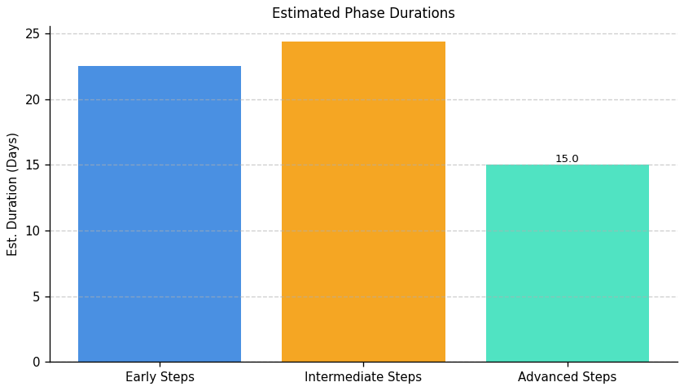
Green With Software: Roadmap Phase Durations

Slide 13
Overall Goal: Fragment B Implementation Plan
Description:
This roadmap initiates with a foundational assessment to identify gaps in server scalability, resource monitoring, and security. The intermediate phase focuses on implementing initial solutions for these areas, integrating them into the existing infrastructure. Finally, the advanced phase concentrates on optimizing performance, establishing redundancy, implementing robust audit processes, and ensuring compliance with relevant industry regulations to create a resilient and secure server environment.
Methodology / Steps:
--- Early Steps ---
1. Assess the current server infrastructure for scalability gaps, conducting workload analysis and collaborating with IT architects. 2. Evaluate and select a resource monitoring tool, researching options and aligning with requirements. 3. Conduct a security threat assessment to identify potential risks and vulnerabilities, collaborating with security experts. 4. Analyze current and projected.
--- Intermediate Steps ---resource demands, collecting usage data and collaborating with business and IT teams. 5. Conduct a network assessment to identify areas for optimization, using network monitoring tools and analyzing traffic patterns
6. Develop a plan for enhancing server infrastructure scalability, identifying solutions and creating a roadmap. 7. Configure and integrate the selected monitoring tool with the server infrastructure, following documentation and testing configurations. 8. Evaluate and select an IDS solution, researching tools and aligning with the threat assessment. 9. Develop a plan to ensure server resources meet current and future demands, defining resource allocation strategies and collaborating with IT and business teams. 10. Develop a plan outlining network optimizations based on assessment findings, collaborating with network experts and prioritizing improvements.
--- Advanced Steps ---
11. Implement the planned upgrades to enhance scalability, upgrading hardware and implementing scaling solutions. 12. Implement resource monitoring in the production environment and provide training. 13. Implement the selected IDS solution and integrate it into the server infrastructure, configuring parameters and performing integration testing. 14. Implement the planned redundancy measures, upgrading hardware and configuring redundant systems. 15. Implement identified network optimizations and monitor the impact, making configuration changes and analyzing performance. 16. Develop a process for auditing server logs for security and compliance, defining audit criteria and collaborating with security and compliance teams. 17. Assess current server configurations for compliance with industry regulations, collaborating with compliance experts and conducting audits. 18. Adjust server configurations to align with industry regulations, implementing necessary changes and collaborating with IT teams.
Roles Involved (Overall): IT Architects, Infrastructure Managers, Scalability Planning Team, IT Leadership, IT Administrators, Infrastructure Team, IT Specialists, Monitoring Team, Monitoring Administrators, Security Analysts, Testing Teams, Business Analysts, Network Administrators, Optimization Experts, Compliance Specialists, Logging System Analysts
Tools/Platforms (Overall): docker, kubernetes, Amazon ECS, Google Kubernetes Engine (GKE), Grafana, Prometheus, Datadog, New Relic, iperf, SolarWinds Network Performance Monitor, Snort, Cisco Firepower, Suricata, Collectd, HAProxy, Nginx, Citrix ADC, F5 BIG-IP, Keepalived, Veeam Backup & Replication, ELK Stack (Elasticsearch, Logstash, Kibana), Splunk, OpenSCAP, Tenable Nessus
Subtask Estimates (Aggregated):
--- Early Steps ---
Scalability Analysis - 25h; Collaboration with IT Architects - 20h; Monitoring Tool Research - 20h; Alignment with Requirements - 15h; Threat Assessment - 20h; Risk Analysis - 15h; Demand Analysis - 25h; Collaboration with Business and IT Teams - 20h; Assessment - 20h; Traffic Pattern Analysis - 15h
--- Intermediate Steps ---
Solution Identification - 30h; Roadmap Creation - 25h; Configuration Setup - 30h; Testing - 25h; Research - 25h; Alignment with Threat Assessment - 20h; Capacity Planning - 30h; Collaboration with IT and Business Teams - 25h; Plan Development - 25h; Collaboration with Experts - 20h
--- Advanced Steps ---
Hardware Upgrade - 40h; Scaling Solution Implementation - 35h; Rollout - 35h; Training - 30h; Configuration - 30h; Integration Testing - 25h; Redundancy Configuration - 35h; Implementation - 30h; Performance Monitoring - 25h; Process Development - 20h; Collaboration with Security and Compliance Teams - 15h; Assessment - 30h; Collaboration with Compliance Experts - 20h; Adjustments - 30h; Collaboration with IT Teams - 25h

Slide 15
Fragment: Green With Software

Slide 16
Green With Software: Top 3 Insights
Disaster recovery planning exists, but its benefits are not consistently realized across all data protection areas, indicating uneven resilience. While a plan and testing are present, practical application needs broadening to ensure comprehensive coverage.
Data lifecycle management is significantly underdeveloped, with defined policies failing to translate into consistent operational practices for backup, archiving, and data integrity verification. This gap creates substantial risk regarding data loss and recovery capabilities.
A formal process for retiring outdated infrastructure is absent, leading to potential cost overruns, security risks, and operational inefficiencies. Establishing a decommissioning process is critical to maintain a secure and optimized IT environment.

Slide 17
Green With Software: Roadmap Overview
Summary: This implementation plan addresses critical gaps in data management and disaster recovery. It focuses on establishing a robust data protection strategy, implementing effective backup and recovery procedures, and defining a clear process for infrastructure decommissioning to mitigate risks and ensure business continuity.
Total Est: 360 hrs (~45.0 days)
Key Roles: Data Owners, IT Operations, IT Security Specialist, Backup Strategist, Documentation Specialist, Testing Coordinator, Infrastructure Specialist, Audit Team, Strategy Development Team, Review Team, System Administrators, Data Stakeholders, IT Specialists, Backup Administrators, IT Administrators

Slide 18
Green With Software: Implementation Plan Details
Overall Goal: Fragment C Implementation Plan
Description:
This roadmap outlines a phased approach to enhance data protection and operational maturity. The initial phase focuses on assessing data criticality and establishing a foundational data protection strategy. The intermediate phase translates this assessment into concrete strategies for backup, recovery, and decommissioning, with a focus on implementation and testing. Finally, the advanced phase emphasizes rigorous validation through testing, comprehensive documentation, and continuous improvement to ensure long-term resilience and adaptability.
Methodology / Steps:
--- Early Steps ---
1. Assess the criticality of different data sets to define backup and archive priorities. 2. Collaborate with data owners using criticality metrics and stakeholders to assess data criticality. 3. Develop a backup policy outlining the frequency, types, and locations of backups. 4. Evaluate and select a backup solution aligned with policy requirements and research backup tools.
--- Intermediate Steps ---
5. Design a comprehensive strategy for backups and archives based on criticality, collaborating with IT security and operations teams and aligning with business needs. 6. Implement the selected backup solution and configure backup schedules. 7. Perform data recovery tests and develop a strategy outlining the criteria, process, and timeline for decommissioning identified components. 8. Gather input from relevant teams and document clear decommissioning guidelines.
--- Advanced Steps ---
9. Document the data protection strategy and develop a test plan outlining scenarios for backup and recovery testing. 10. Collaborate with IT teams to identify critical scenarios and execute test scenarios. 11. Analyze results and establish a routine for reviewing and updating the decommissioning strategy. 12. Conduct periodic reviews and consider technological advancements.
Roles Involved (Overall): Data Owners, IT Operations, IT Security Specialist, Backup Strategist, Documentation Specialist, Testing Coordinator, Infrastructure Specialist, Audit Team, Strategy Development Team, Review Team, System Administrators, Data Stakeholders, IT Specialists, Backup Administrators, IT Administrators
Tools/Platforms (Overall): Bacula, Duplicity, Commvault, Veeam Backup & Replication, Amanda
Subtask Estimates (Aggregated):
--- Early Steps ---
Collaboration and Planning - 15h; Criticality Assessment - 25h; Policy Development - 20h; Stakeholder Collaboration - 15h; Research - 25h; Policy Alignment - 20h
--- Intermediate Steps ---
Strategy Design - 30h; Business Needs Alignment - 20h; Configuration - 30h; Data Recovery Testing - 25h; Team Collaboration - 18h; Document Development - 25h
--- Advanced Steps ---
Documentation - 18h; Testing Scenarios - 22h; Test Plan Development - 20h; IT Team Collaboration - 15h; Testing Execution - 30h; Results Analysis - 25h; Periodic Reviews - 22h; Strategy Updates - 20h

Slide 19
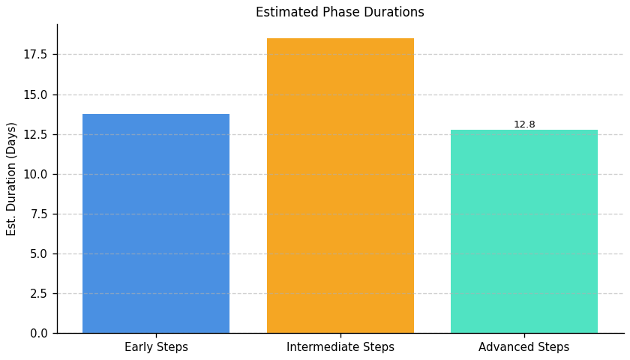
Green With Software: Roadmap Phase Durations

Slide 20
Fragment: Green With Software

Slide 21
Green With Software: Top 3 Insights
The organization demonstrates a strong commitment to operational energy efficiency within IT, evidenced by frequent audits, but this focus isn’t matched by equivalent investment in developing internal sustainability expertise. This creates a risk of identifying opportunities without the capacity to fully implement or innovate solutions.
A significant barrier to scaling Green IT initiatives is the absence of dedicated ownership and accountability; while employee awareness exists, a lack of a responsible team or individual hinders tracking progress and driving broader adoption beyond isolated positive behaviors.
The organization’s sustainability talent strategy is underdeveloped, lacking formal recruitment, assessment, or retention programs for carbon-literate skills, and crucially, mentorship opportunities – limiting the long-term embedding of sustainability principles within the workforce.

Slide 22
Green With Software: Roadmap Overview
Summary: This roadmap addresses the need to integrate sustainability into the organization's IT practices. It focuses on assessing environmental impact, implementing resource optimization processes, developing employee skills, and establishing governance to attract and retain carbon-literate talent. The goal is to embed environmental responsibility into the organization's culture and operations.
Total Est: 258 hrs (~32.2 days)
Key Roles: Environmental Specialist, IT Operations, Process Design Expert, Documentation Specialist, Training Coordinator, Tool Administrators, Sustainability Analysts, HR Specialists, Department Heads, Training Analysts, Program Designers, Program Coordinators, Assessment Designers, Subject Matter Experts, HR Representatives, Mentoring Coordinators, Sustainability Strategists, Communication Specialists, Infrastructure Managers, Training Facilitators

Slide 23
Green With Software: Implementation Plan Details
Overall Goal: Green With Software Implementation Plan
Description:
This roadmap guides the organization through a phased approach to Green IT implementation. The Early Steps focus on establishing a baseline understanding of environmental impact and designing resource optimization processes. Intermediate Steps involve implementing these processes, evaluating sustainability tools, and assessing infrastructure. Finally, the Advanced Steps concentrate on developing employee skills, attracting carbon-literate resources, and establishing governance to ensure long-term sustainability.
Methodology / Steps:
--- Early Steps ---
1. Conduct an assessment of the organization's current environmental impact. 2. Collaborate with environmental specialists and utilize assessment tools. 3. Design processes to optimize resource usage based on assessment results, aligning with environmental goals.
--- Intermediate Steps ---
4. Assess the environmental impact of existing infrastructure and processes. 5. Collaborate with environmental experts and utilize impact assessment tools. 6. Evaluate existing and potential tools for managing sustainability, researching available options and collaborating with IT teams.
--- Advanced Steps ---
7. Identify specific sustainability-focused skills needing development and conduct a skill gap analysis, collaborating with department heads. 8. Design training programs for sustainability skills development, collaborating with trainers to define program content. 9. Implement training programs and track participant progress, conducting training sessions and monitoring engagement. 10. Define a structured incentive plan for carbon-literate resources, collaborating with HR to design programs and communicate the plan to employees through awareness sessions and developed communication materials.
Roles Involved (Overall): Environmental Specialist, IT Operations, Process Design Expert, Documentation Specialist, Training Coordinator, Tool Administrators, Sustainability Analysts, HR Specialists, Department Heads, Training Analysts, Program Designers, Program Coordinators, Assessment Designers, Subject Matter Experts, HR Representatives, Mentoring Coordinators, Sustainability Strategists, Communication Specialists, Infrastructure Managers, Training Facilitators
Tools/Platforms (Overall): Assessment tools, Sustainability tools, Impact assessment tools, Training platforms, Communication tools
Subtask Estimates (Aggregated):
--- Early Steps ---
Collaboration and Planning - 20h; Impact Assessment - 30h; Process Design - 25h; Alignment with Goals - 18h.
--- Intermediate Steps ---
Environmental Assessment - 30h; Collaboration with Experts - 20h; Tool Research - 25h; Collaboration with IT Teams - 15h.
--- Advanced Steps ---
Skill Gap Analysis - 20h; Collaboration with Department Heads - 15h; Program Design - 30h; Collaboration with Trainers - 20h; Training Sessions - 35h; Progress Tracking - 25h; Incentive Structure Definition - 25h; Collaboration with HR - 15h; Communication Development - 30h; Awareness Sessions - 20h.

Slide 24
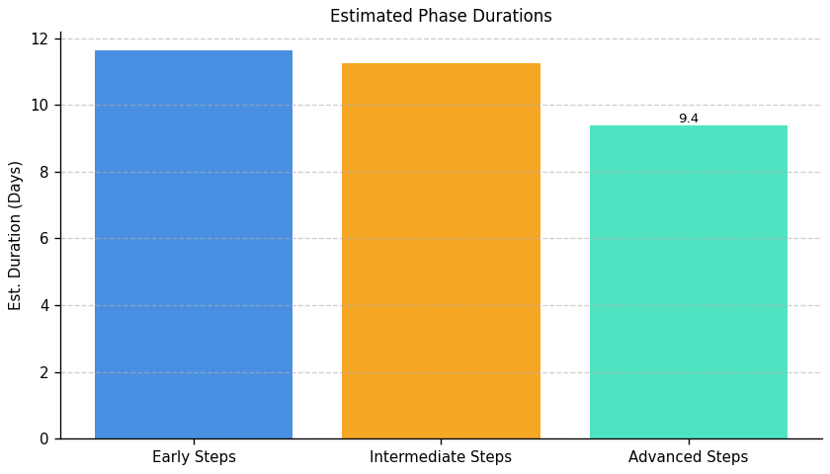
Green With Software: Roadmap Phase Durations

Slide 25
Fragment: Green With Software

Slide 26
Green With Software: Top 3 Insights
The organization demonstrates initial commitment to IT carbon reduction through data center power management and renewable energy efforts, but lacks the comprehensive measurement needed to drive substantial progress.
A critical gap exists in quantifying the organization’s total IT carbon footprint; without this baseline, setting effective reduction targets and demonstrating impact is impossible.
Current efforts to improve carbon intensity of server operations have stalled, indicating that existing strategies are insufficient and more significant changes to IT infrastructure and practices are required to achieve meaningful emissions reductions.

Slide 27
Green With Software: Roadmap Overview
Summary: This roadmap outlines a phased approach to reducing the IT carbon footprint of Green With Software. It begins with establishing a baseline measurement of IT emissions, progresses through renewable energy adoption and power optimization, and culminates in a strategic, data-driven carbon reduction plan. The goal is to improve carbon intensity and establish a continuous improvement cycle.
Total Est: 64 hrs (~8.0 days)
Key Roles: IT Operations, Sustainability Team, Data Analytics

Slide 28
Green With Software: Implementation Plan Details
Overall Goal: Green With Software IT Carbon Reduction Roadmap
Description:
This roadmap guides Green With Software through a three-phase process to minimize its IT carbon footprint. The Early Steps focus on establishing a baseline understanding of current emissions and defining key metrics. Intermediate Steps build upon this foundation by increasing renewable energy usage and optimizing power consumption. Finally, the Advanced Steps establish a long-term strategy for continuous improvement, leveraging data analytics and server optimization to drive ongoing carbon reductions.
Methodology / Steps:
--- Early Steps ---
1. Define a standardized method for calculating the IT carbon footprint, including scope and boundaries. 2. Implement a system to track carbon emissions per user as a primary carbon intensity metric. 3. Collect data for the past year to establish a baseline carbon footprint in metric tons of CO2 equivalent. 4. Document the data collection process, reporting frequency, and data sources.
--- Intermediate Steps ---
5. Evaluate opportunities to increase the proportion of renewable energy used for data centers and IT operations. 6. Refine power management settings on devices to maximize energy savings. 7. Investigate and implement server virtualization to consolidate workloads and reduce energy consumption. 8. Monitor the impact of renewable energy and power optimization efforts on carbon intensity metrics.
--- Advanced Steps ---
9. Conduct a detailed assessment of server operations to identify areas for carbon reduction, including cooling and hardware utilization. 10. Implement cooling optimization techniques to improve server energy efficiency. 11. Establish key performance indicators (KPIs) for carbon intensity and track progress against targets. 12. Regularly review and update the carbon reduction strategy based on performance data, emerging technologies, and best practices. 13. Explore opportunities for workload scheduling to align with renewable energy availability. 14. Implement data analytics platforms to identify trends and optimize resource allocation.
Roles Involved (Overall): IT Operations, Sustainability Team, Data Analytics
Tools/Platforms (Overall): Carbon accounting software, Power management tools, Virtualization platforms, Data analytics platforms, Server monitoring tools
Subtask Estimates (Aggregated):
--- Early Steps ---
Metric Definition - 8h; Tracking System Implementation - 12h; Data Collection - 4h; Documentation - 2h.
--- Intermediate Steps ---
Renewable Energy Evaluation - 6h; Power Management Refinement - 4h; Virtualization Implementation - 4h; Monitoring Setup - 2h.
--- Advanced Steps ---
Server Assessment - 4h; Cooling Optimization - 4h; KPI Definition - 2h; Strategy Review - 4h; Data Analytics Implementation - 8h.

Slide 29
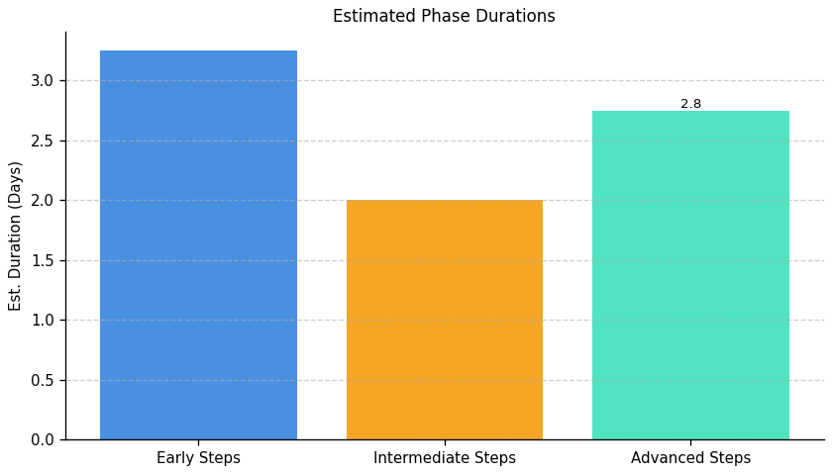
Green With Software: Roadmap Phase Durations

Slide 30
Fragment: Green With Software

Slide 31
Green With Software: Top 3 Insights
The organization demonstrates awareness of IT sustainability principles, particularly regarding environmental impact and recyclability, but consistently fails to translate this awareness into concrete, organization-wide practices.
A significant gap exists between stated sustainability priorities and actual IT asset management, specifically lacking a formal policy for responsible e-waste disposal which risks unsustainable handling of end-of-life equipment.
Current equipment lifecycle management is at an introductory level, requiring substantial development to move beyond basic considerations and implement a truly circular IT asset approach focused on reuse and responsible end-of-life processing.

Slide 32
Green With Software: Roadmap Overview
Summary: This roadmap addresses the need for a more formalized and proactive approach to IT equipment lifecycle management and e-waste disposal. It outlines steps to establish a foundational e-waste policy, integrate environmental considerations into procurement, and optimize practices for circularity and continuous improvement. Successful implementation will reduce environmental impact and ensure responsible IT resource management.
Total Est: 50 hrs (~6.2 days)
Key Roles: Procurement, IT Operations, Sustainability Officer

Slide 33
Green With Software: Implementation Plan Details
Overall Goal: Fragment F Implementation Plan: Green With Software
Description:
This roadmap guides the organization through a phased approach to improve its environmental sustainability in IT. It begins with establishing a formal e-waste policy and identifying certified recycling vendors. The intermediate phase focuses on integrating environmental criteria into procurement processes and implementing basic asset tracking. Finally, the advanced phase aims to optimize lifecycle management for circularity, extending equipment lifespan, maximizing reuse, and continuously monitoring and improving e-waste reduction efforts.
Methodology / Steps:
--- Early Steps ---
1. Research best practices for e-waste disposal and recycling. 2. Draft a preliminary e-waste policy outlining disposal procedures. 3. Identify and vet certified e-waste recycling vendors. 4. Communicate the draft policy to key stakeholders for feedback and incorporate revisions.
--- Intermediate Steps ---
5. Integrate environmental criteria, including recyclability and energy efficiency, into IT procurement guidelines. 6. Implement an asset tracking system to monitor equipment lifecycle stages. 7. Develop a process for evaluating the environmental impact of potential IT purchases. 8. Train procurement staff on the new environmental criteria and asset tracking procedures.
--- Advanced Steps ---
9. Explore options for extending equipment lifespan through refurbishment, upgrades, and repair. 10. Investigate opportunities for equipment reuse within the organization or through donation programs. 11. Establish key performance indicators (KPIs) to track e-waste reduction progress and overall sustainability performance. 12. Conduct regular audits of e-waste disposal practices to ensure compliance and identify areas for improvement.
Roles Involved (Overall): Procurement, IT Operations, Sustainability Officer
Tools/Platforms (Overall): Document Management System, Vendor Databases, Asset Management Software, Procurement Systems, Reporting Tools
Subtask Estimates (Aggregated):
--- Early Steps ---
Research (8h); Drafting (12h); Vendor Identification (4h); Communication (4h)
--- Intermediate Steps ---
Procurement Integration (6h); Asset Tracking Implementation (4h); Impact Evaluation Process (2h); Training (2h)
--- Advanced Steps ---
Lifespan Extension Research (2h); Reuse Investigation (2h); KPI Establishment (2h); Auditing (2h)

Slide 34
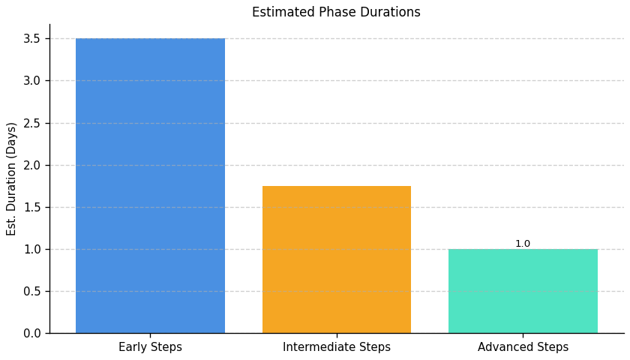
Green With Software: Roadmap Phase Durations

